Slide 1
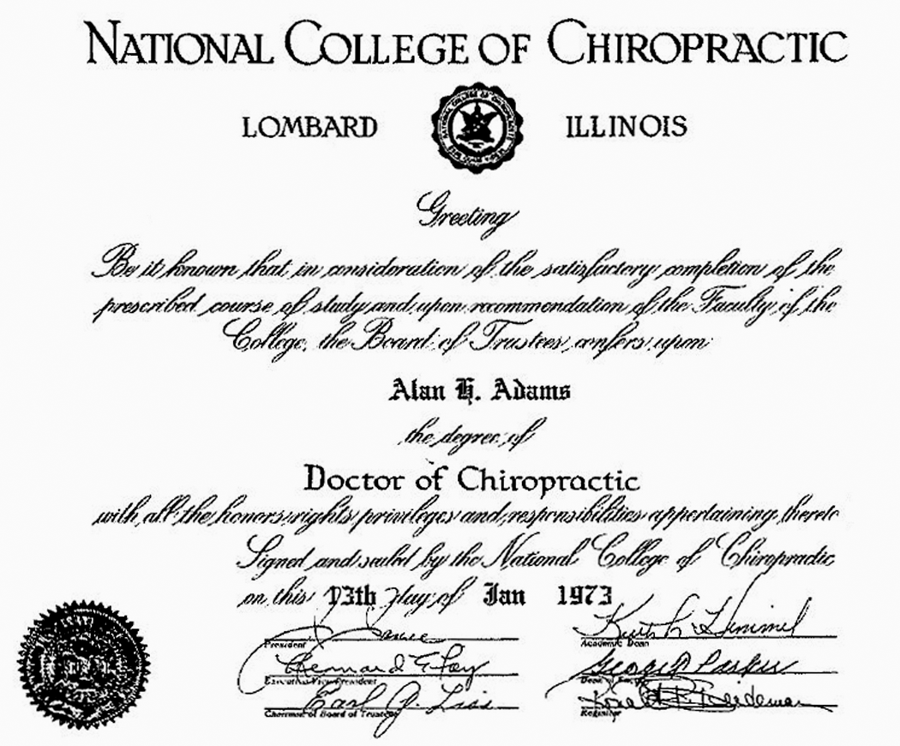
From: In memoriam of Alan H. Adams, DC, MS, MSEd:Health professions educator and chiropractic research pioneer
J Chiropr Educ. 2021;35(2):159-170. doi:10.7899/JCE-21-35
Figure Legend:
Dr Alan Adams' Diploma 1973.

Slide 2
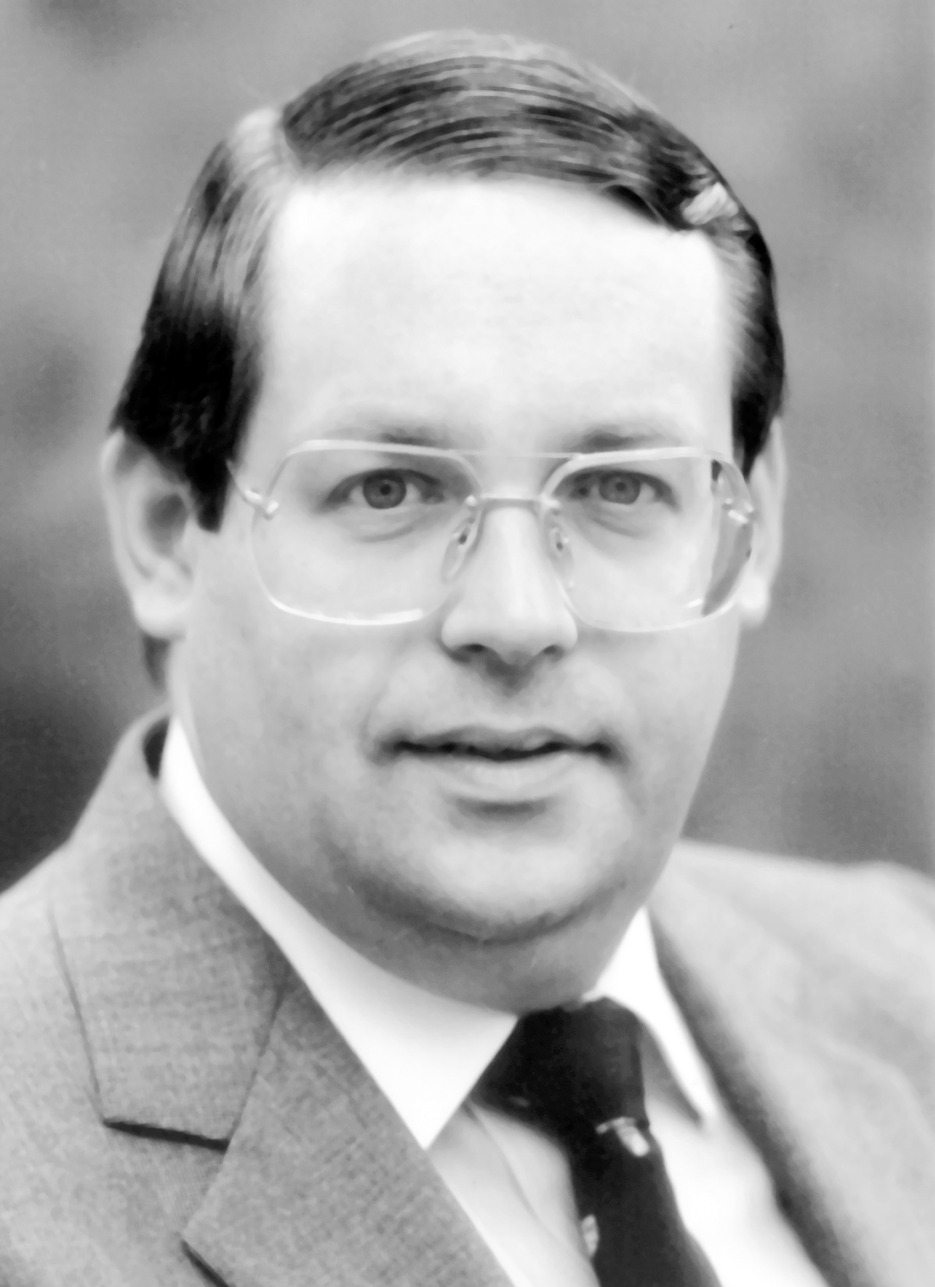
From: In memoriam of Alan H. Adams, DC, MS, MSEd:Health professions educator and chiropractic research pioneer
J Chiropr Educ. 2021;35(2):159-170. doi:10.7899/JCE-21-35
Figure Legend:
Dr Alan Howard Adams.

Slide 3
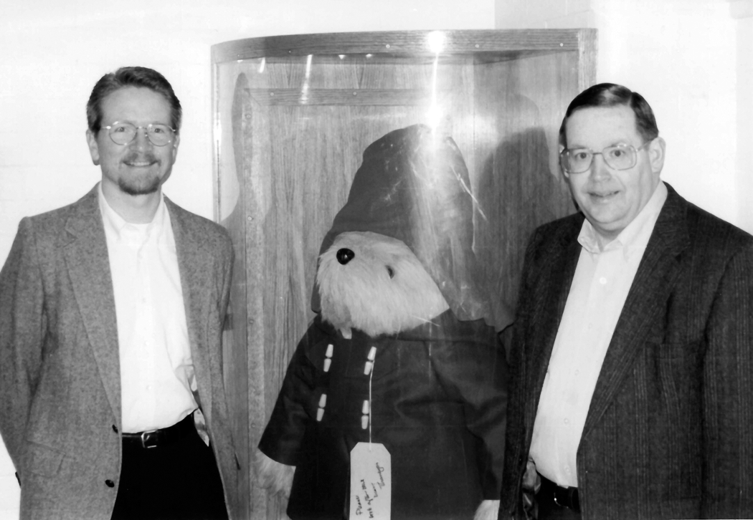
From: In memoriam of Alan H. Adams, DC, MS, MSEd:Health professions educator and chiropractic research pioneer
J Chiropr Educ. 2021;35(2):159-170. doi:10.7899/JCE-21-35
Figure Legend:
Bart Green and Alan Adams at the Paddington Station in London on their way home from the 1996 International Conference on Spinal Manipulation, October 18–19, 1996, Bournemouth International Centre, Bournemouth, England (photo from Claire Johnson).

Slide 4
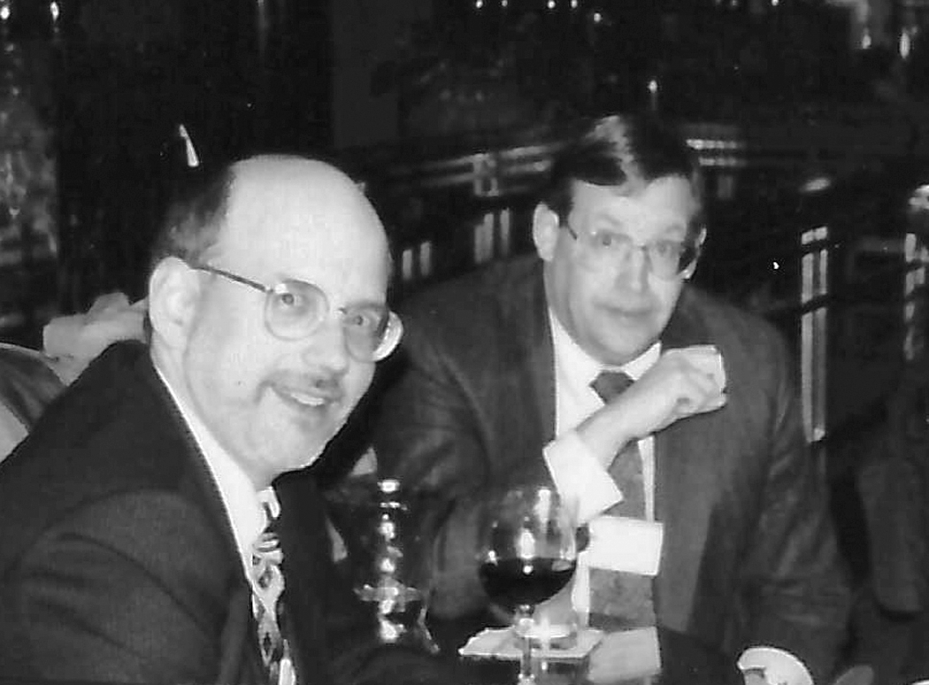
From: In memoriam of Alan H. Adams, DC, MS, MSEd:Health professions educator and chiropractic research pioneer
J Chiropr Educ. 2021;35(2):159-170. doi:10.7899/JCE-21-35
Figure Legend:
Drs John Mrozek and Alan Adams meeting after a long day at the American Educational Research Association conference (photo from Claire Johnson).

Slide 5
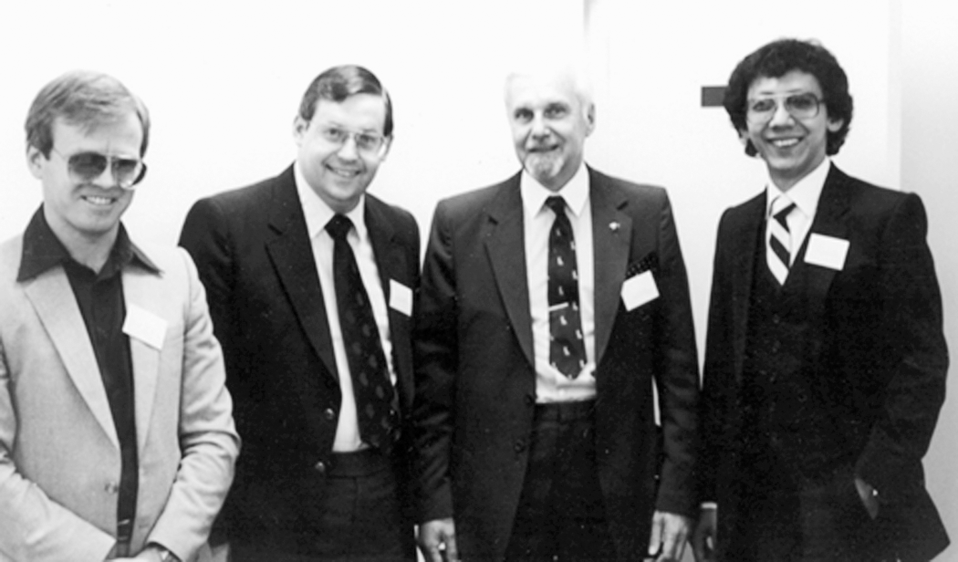
From: In memoriam of Alan H. Adams, DC, MS, MSEd:Health professions educator and chiropractic research pioneer
J Chiropr Educ. 2021;35(2):159-170. doi:10.7899/JCE-21-35
Figure Legend:
At the Canadian Memorial Chiropractic College, the English medical scholar Barry Wyke was invited to address a chiropractic audience. He was the first of some outstanding scholars who Alan brought to campus but who had never spoken to chiropractors before. He did the same at the Los Angeles College of Chiropractic as well. From left to right: Ian Coulter; Alan Adams; Barry Wyke, MD, BS Neurological Laboratory, Department of Applied Physiology, Royal College of Surgeons of England; Benjamin Yuen, DC, Director postgraduate and continuing education at Canadian Memorial Chiropractic College (photo from Joseph C. Keating, Jr historical collection).

Slide 6
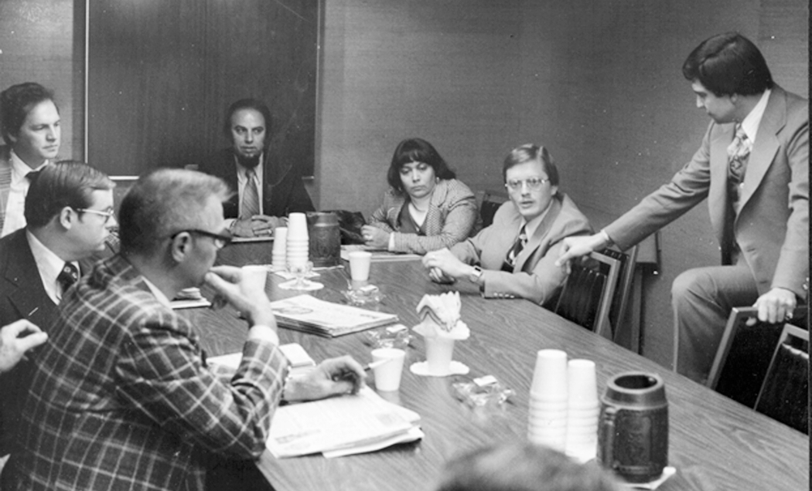
From: In memoriam of Alan H. Adams, DC, MS, MSEd:Health professions educator and chiropractic research pioneer
J Chiropr Educ. 2021;35(2):159-170. doi:10.7899/JCE-21-35
Figure Legend:
Meeting during the Clinical Laboratory Considerations in Coal Workers' Pneumoconiosis, presented at the Governor's Conference on Experimental Approaches to the Investigation of Chiropractic Management in Pneumoconiosis, December 1976, King of Prussia, PA. Starting clockwise from bottom left, Dr John Heilman, Dr Al Adams, Dr Scott Haldeman, Dr Sion Kaftari, Dr Josefa Cubina, Dr James Winterstein, Dr Louis Sportelli (photo from Louis Sportelli).

Slide 7
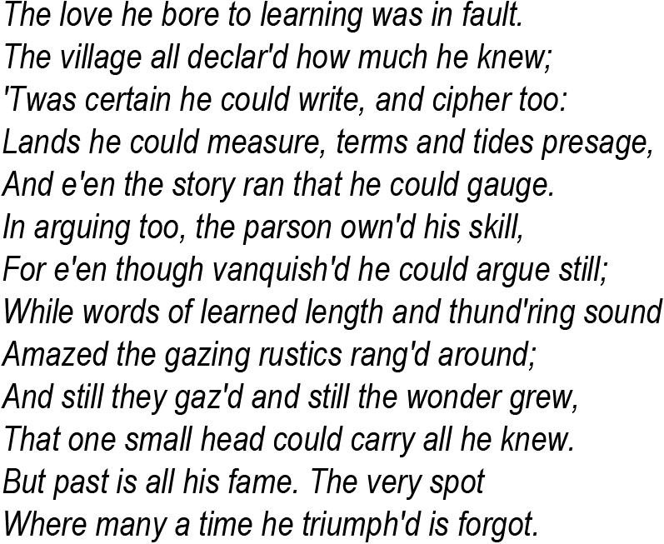
From: In memoriam of Alan H. Adams, DC, MS, MSEd:Health professions educator and chiropractic research pioneer
J Chiropr Educ. 2021;35(2):159-170. doi:10.7899/JCE-21-35
Figure Legend:
A portion of a poem from Oliver Goldsmith's book The Deserted Village, 1888.

