Slide 1
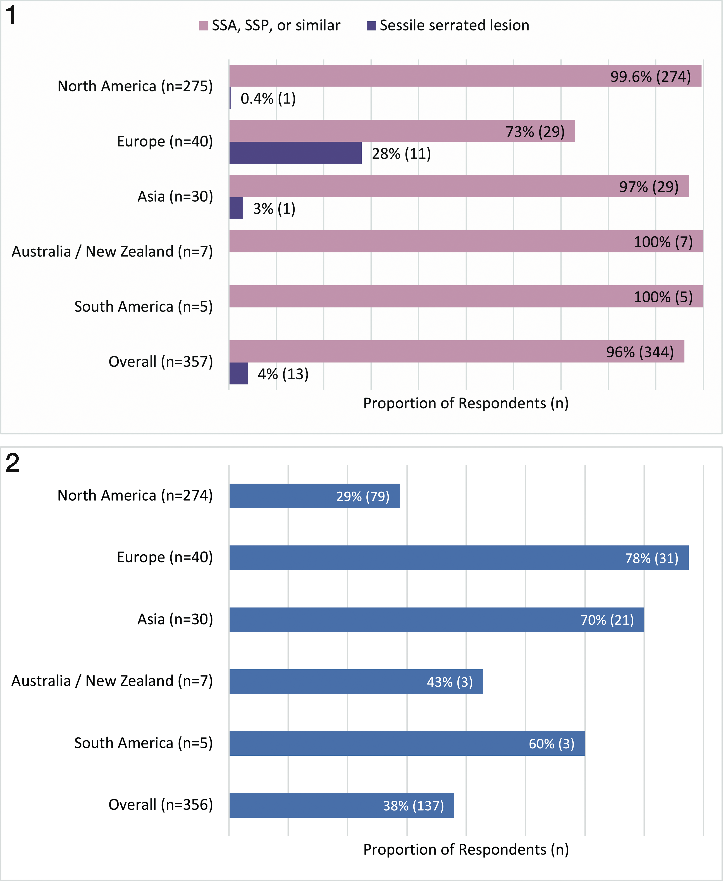
From: Attitudes Regarding the World Health Organization–Recommended Term Sessile Serrated Lesion: Results From an International Survey
Arch Pathol Lab Med. 2021;145(10):1189-1190. doi:10.5858/arpa.2021-0133-LE
Figure Legend:
Regional differences in terminology preference prior to new recommendations. Most respondents used sessile serrated adenoma (SSA), sessile serrated polyp (SSP), or similar terminology. Significantly more European pathologists (28%) already used the term sessile serrated lesion compared with other regions (P < .001).
Figure 2. Regional differences in acceptance of the term sessile serrated lesion. Relatively few North American pathologists (29%) responded that they planned on adopting the new terminology, whereas respondents from Europe (78%) and Asia (70%) appeared generally in favor of using sessile serrated lesion going forward (P < .001). Note: One North American respondent did not provide a response.

